Slide 1
Routing and Checkers
Workshop Session 7,8
Presented by
Aireen Amir Jalal

Slide 2
Design.v, Design.sdc, Std_cells.lef, Std_cells.lib
Input
Synthesis
Yosys, OpenSTA
Design_gate_level_netlist.v
Output
Design_gate_level_netlist.v, macro.lef, macro.cfg
Input
Floorplanning/Power Network
init_fp, ioplacer, pdn
Floorplan.def
Output
Floorplan.def
Input
Placement
RePLace,OpenDP
Placement.def
Output
Open-source EDA Tools
Design_gate_level_netlist.v, Placement.def
Input
CTS
TritonCTS
CTS.def, CTS_netlist.v
Output
Input
Routing
FastRoute, TritonRoute
CTS.def
Routing.def
Output
Input
RC Extraction
SPEF-Extractor
Routing.def
Design.spef
Output
Input
GDS Generation
Magic
Input
Routing.def
Output
Output
Design.gds, Design.lef
Input
Physical Verification
APR Step
Design.gds
Magic
EDA Tool

Slide 3
Contents
What is Routing
Global Routing
Detailed Routing
Filler Insertion
Design Rule Check (DRC)
Layout Vs. Schematic (LVS)
LAB PRACTICE

Slide 4
What is Routing
Routing is the stage after the CTS where,
Interconnects are established by determining precise paths for each nets
This includes interconnections of the standard cells, macro pins and I/O pads of the chip
Tool knows the exact location of the standard cells, macros and IO pads
Metal layers are used to create the electrical connections to complete the connectivity as defined in the net list
Routing in OpenLANE is a two stage process;
Global routing - fastroute
Detailed Routing- tritonroute

Slide 5
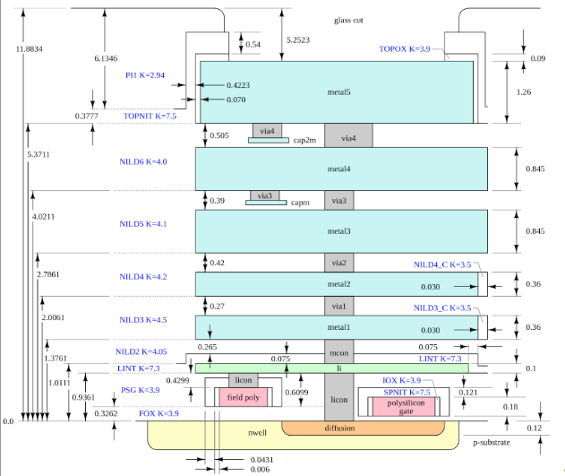
Remember this ?
Interconnects are implemented using available metal layers in sky130nm technology.

Slide 6
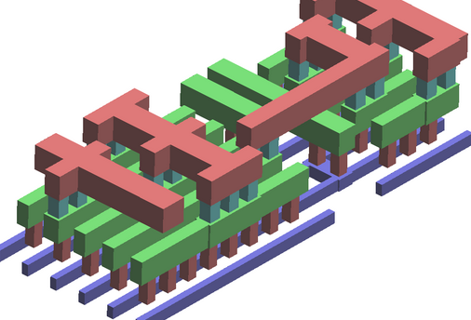
Routing
Metal layers are placed on top of each other in alternating directions.
This avoids the capacitive effect to arise between parallel metal plates.

Slide 7
Routing
Let's Consider this example,
Launch Flop
Capture Flop
ff1
Q1
ff2
D2
Din1
Dout1
Clk
ff1
D2
ff2
Din2
Q1
Dout2

Slide 8
Routing
Global Routing
I/O PAD AREA
Rough routing guides are established
Outlines for actual route
Not actual routing
Din1
Dout1
ff1
1
2
ff2
I/O PAD AREA
I/O PAD AREA
ff1
1
2
ff2
Din2
Dout2
I/O PAD AREA

Slide 9
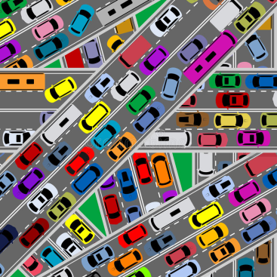

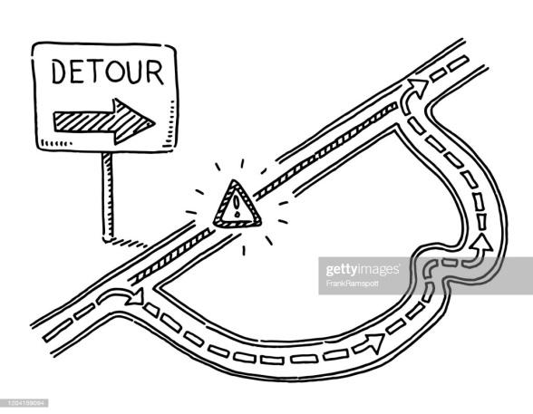
Why global routing?
Analyze congestions
Identifies available paths
Minimizes detouring

Slide 10
Routing
Detailed Routing
I/O PAD AREA
Din1
Dout1
Actual interconnects established
Least detoured path considered
Multiple iterations are performed to overcome Design Rule Violations
ff1
1
2
ff2
I/O PAD AREA
I/O PAD AREA
ff1
1
2
ff2
Din2
Dout2
I/O PAD AREA

Slide 11
Maze Routing - LEE’s Algorithm
A commonly used Algorithm,
Path between two points is found and connection established
The idea is to create a path between Source and Target of two cells,
I/O PAD AREA
Cell1 S
6
5
4
5
6
6
5
4
3
2
1
2
3
4
5
I/O PAD AREA
I/O PAD AREA
7
6
5
4
3
2
3
4
5
6
7
6
5
4
3
4
5
6
7
Cell 2
T
7
6
5
4
5
6
7
8
7
6
5
6
7
7
6
7
I/O PAD AREA

Slide 12
LEE’s Algorithm
I/O PAD AREA
I/O PAD AREA
Cell1 S
Cell1 S
6
5
4
5
6
6
5
4
5
6
6
5
4
3
2
1
2
3
4
5
6
5
4
3
2
1
2
3
4
5
I/O PAD AREA
I/O PAD AREA
I/O PAD AREA
I/O PAD AREA
7
6
5
4
3
2
3
4
5
6
7
6
5
4
3
2
3
4
5
6
7
6
5
4
3
4
5
6
7
Cell 2
7
6
4
4
5
6
7
Cell 2
T
5
3
T
7
6
5
4
5
6
7
8
7
6
5
4
5
6
7
8
7
6
5
6
7
7
6
5
6
7
7
6
7
7
6
7
I/O PAD AREA
I/O PAD AREA
Path 1
Path 2

Slide 13
Filler Cell Insertion
I/O PAD AREA
Gaps in between the standard cells in the rows and rail discontinuity, results in DRC violations.
Filler cells are usually added which are physical cells containing n-well, p-well and power rails.
Din1
Dout1
ff1
1
2
ff2
I/O PAD AREA
I/O PAD AREA
ff1
1
2
ff2
Din2
Dout2
I/O PAD AREA

Slide 14
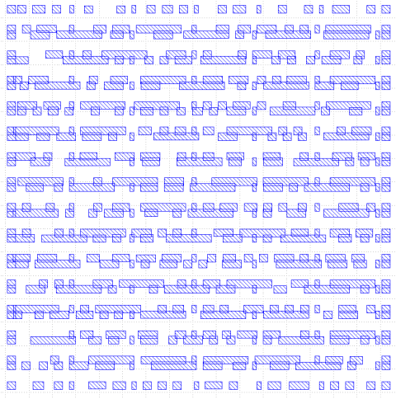
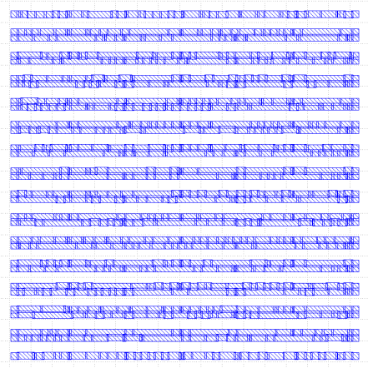
Before and After Filler cell Insertion
N-Well mask before filler insertion
N-Well mask after filler insertion

Slide 15
Sign Off
Checks to ensure that,
Final layout implements all design rules
Identify any unmatched nets that may occur due to short/open circuits.
Layout Vs Schematic (LVS) identifies any differences in the nets.

Slide 16
Design Rule Check (DRC)
DRC is based on the technology file provided along with the PDK.
Magic is used for Design Rules Checking.
Let’s take this example to understand DRC!

Slide 17
DRC
So after routing certain design rules are checked to ensure seamless routing.
I/O PAD AREA
Din2
Dout1
ff1
1
2
ff2
I/O PAD AREA
I/O PAD AREA
ff1
1
2
ff2
Din1
Dout2
I/O PAD AREA

Slide 18
Some common DRC rules
Remember what you see on the mask is what you see on the silicon!
1. Wire width
2. Wire Spacing
t1
t2
t1
t2

Slide 19
DRC
Next set of common DRC’s occur when,
I/O PAD AREA
Din2
Dout1
ff1
1
2
ff2
I/O PAD AREA
I/O PAD AREA
ff1
1
2
ff2
Din1
Dout2
I/O PAD AREA

Slide 20
DRC Violation
DRC violation type: Signal Short
Solution: Use different metal layers

Slide 21
Some common DRC rules
1. Via width
2. Via Spacing

Slide 22
Layout Vs. Schematic
Netgen is used for Layout Vs Schematic LVS check.
Two step process:
Extraction: The process extracts the devices and their connectivity from the physical layout, and then generates a netlist interpretation of the layout to be used in the comparison step.
Comparison: The process compares the extracted netlist to the schematic netlist, and reports all discrepancies, which must then be debugged and resolved.
Extracted SPICE by Magic vs. Verilog netlist

Slide 23
Key Things To Remember
Metal 4 and 5 are usually used for power routing, i.e. for the power grid.
Routing violations must be avoided.
The design needs to be DRC and LVS clean.
This can be achieved by tweaking and tuning design parameters in the flow.

Slide 24
LAB PRACTICE

